Slide 1

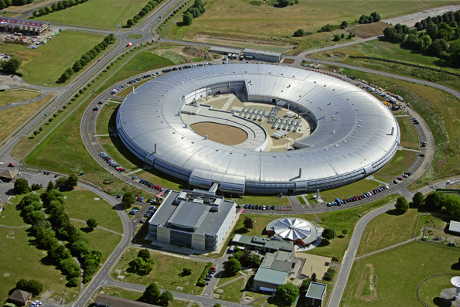
areaDetector Data Processing Pipeline In EPICS V4
Dave Hickin
Diamond Light Source
EPICS Collaboration Meeting
Diamond Light Source 01/05/2013

Slide 2
Objectives
Lossless high-performance transfer of detector data and camera images including metadata.
Software infrastructure to support it.
Framework for high performance scientific data services

Slide 3
Why transfer detector data?
Transferring data between platforms
(Usually from Windows to Linux)
  Cameras often have Windows only support
  Better support for HPC in Linux, e.g. HP file system
  Linux toolchain
  Preference for Linux (open source, reliability etc.)
  More expertise on Linux
Distributing processing

Slide 4
Case Study – I12 Beamline
I12 Beamline at Diamond
  Joint Engineering, Environmental and Processing(JEEP)
  Imaging, Tomography, X-ray diffraction, SAXS
PCO detector, Windows-only support
HDF5-writer, Lustre distributed files system
~90 10MB images per second
10 Gig Ethernet

Slide 5
areaDetector overview
Provides a general-purpose interface for detectors and cameras in EPICS
Easily extensible
Supports wide variety of detectors and cameras
High-performance
Mechanism for device-independent real-time data analysis

Slide 6
areaDetector overview (cont)
Camera drivers inherit from base class ADDriver
Drivers produces NDArrays
    Data; timestamp; size, offset, reverse, binning; unique ID
    Attributes (name, description, source(+type), value)
Run plugins
Plugins inherit from NDPluginDriver
Connect to asyn port on a driver
Consume NDArrays

Slide 7
areaDetector and EPICS V4
areaDetector runs a plugin which is a pvAccess server
Plugin translates NDArrays into EPICS V4 structured data (normative type). Closely maps to NDArray.
pvAccess used to transfer data
V4 client implements ADDriver
Translates V4 type back into NDArray
Passes NDArrays to plugins

Slide 8
Current State of Development
Existing solution
  James Rowland, Ulrik Pedersen, Jon Thomson at Diamond
  Ad hoc solution
  Doesn’t use pvAccess network protocol or EPICS V4 core code
  Uses pvAccess serialisation and data structure
  Server pushes data to client
  Runs on Windows
  Optimised. Very efficient (95% usage of 10Gig Ethernet)
EPICS V4 Prototype
  Early stages of development
  Uses pvAccess and EPICS V4 core code
  Client monitors PV
  Linux only. No Windows support yet.

Slide 9
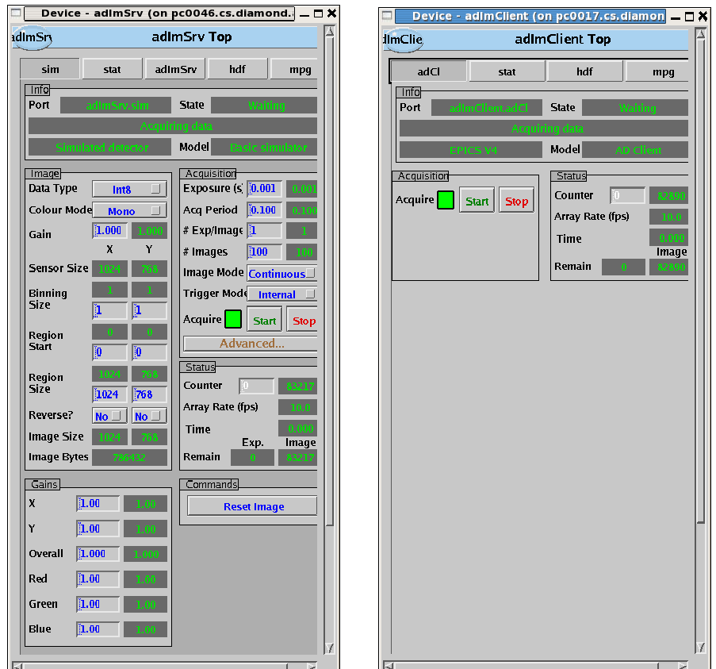
EPICS V4 Server and Client Prototype

Slide 10
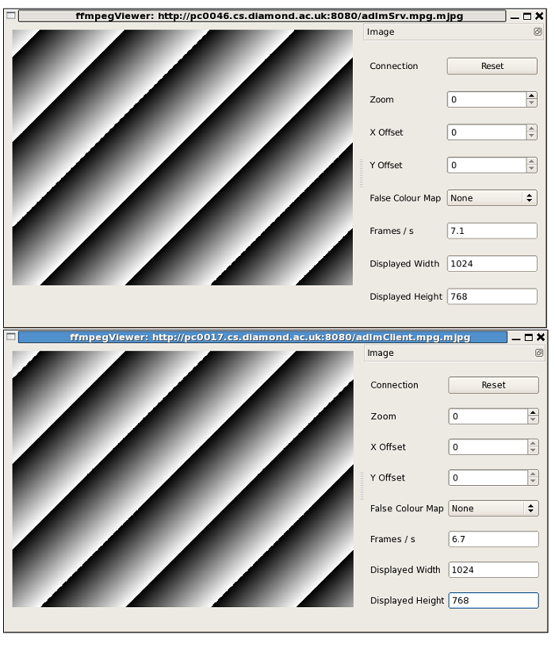
Prototype: Images

Slide 11
Development Plan for areaDetector data processing
For this charter
Use standard V4 libraries
Optimise performance
Run on Windows
Package
Beyond:
Configuration (e.g. RPC request)
Other solutions

Slide 12
Associated development plan for EPICS V4 Base
Development of EPICS V4 libraries - local channel provider for C++ (Marty Kramer)
Efficient handling of large arrays to reduce copying (Michael Davidsaver)
Windows support (Matej Sekoranja)
Broadcast/Multicast (Matej Sekoranja)

